Slide 1
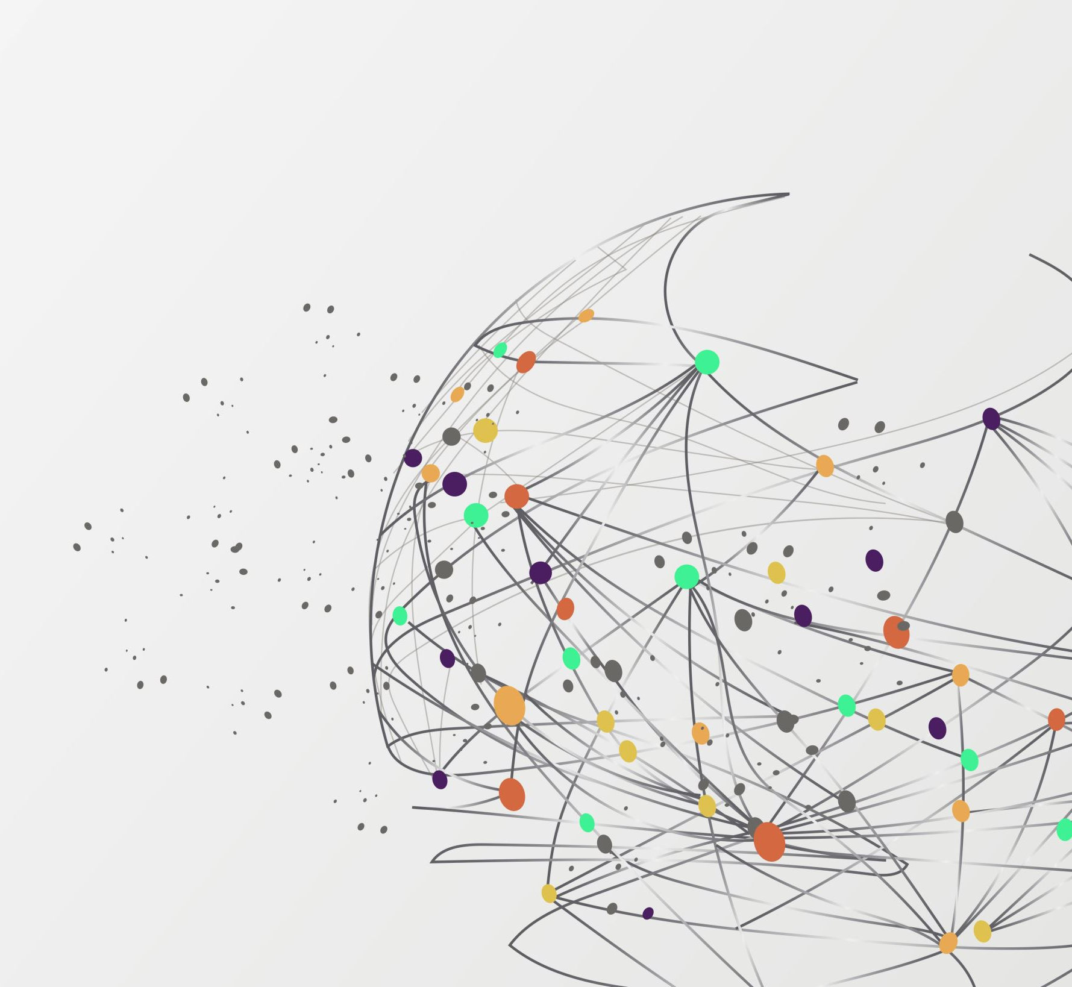
LULC Level-2 Classification Using AI/ML
MINOR PROJECT
Supervisor : Dr. Nancy Singla
GROUP NO - 57
Submitted By:
Prakhar Varshney (211327)

Slide 2
Contents
Introduction
Problem Statement and objective
System Design
Pseudocode
Experimental Result and Analysis
Conclusion
References

Slide 3
What is LULC &
Level-2 Classification
INTRODUCTION
LULC: Land Use and Land Cover (LULC) refers to a classification system used to categorize and describe the various types of land cover and land use across a geographical area.
Land Use refers to the human activities and purposes for which land is utilized. eg - Residential (urban, suburban)
Land Cover describes the physical and biological materials on the Earth's surface, including natural and artificial features. eg - Forest , Grassland , Wetland etc
Level 2 classification is an intermediate level of classification between higher levels of generalization(Level 1 classification) and more detailed levels of specificity (Level 3 classification).
In a Level 2 classification system, land cover types are grouped into relatively broad and distinct categories, which may include classes such as forests, urban areas, agricultural land, water bodies, barren land, etc.

Slide 4
Uses of Machine learning in LULC Level-2 Classification
CONT..
Automated Feature Extraction:
ML algorithms can automatically extract relevant features from satellite imagery, such as texture, color, and spatial patterns, without the need for manual feature engineering.
Multi-class Classification:
Machine learning algorithms excel in multi-class classification tasks by effectively distinguishing between different land cover types based on their unique spectral signatures.
Handling Large Datasets:
Machine learning techniques are well-suited for handling large volumes of satellite data, which is often the case in Level 2 classification tasks covering extensive geographical areas.

Slide 5
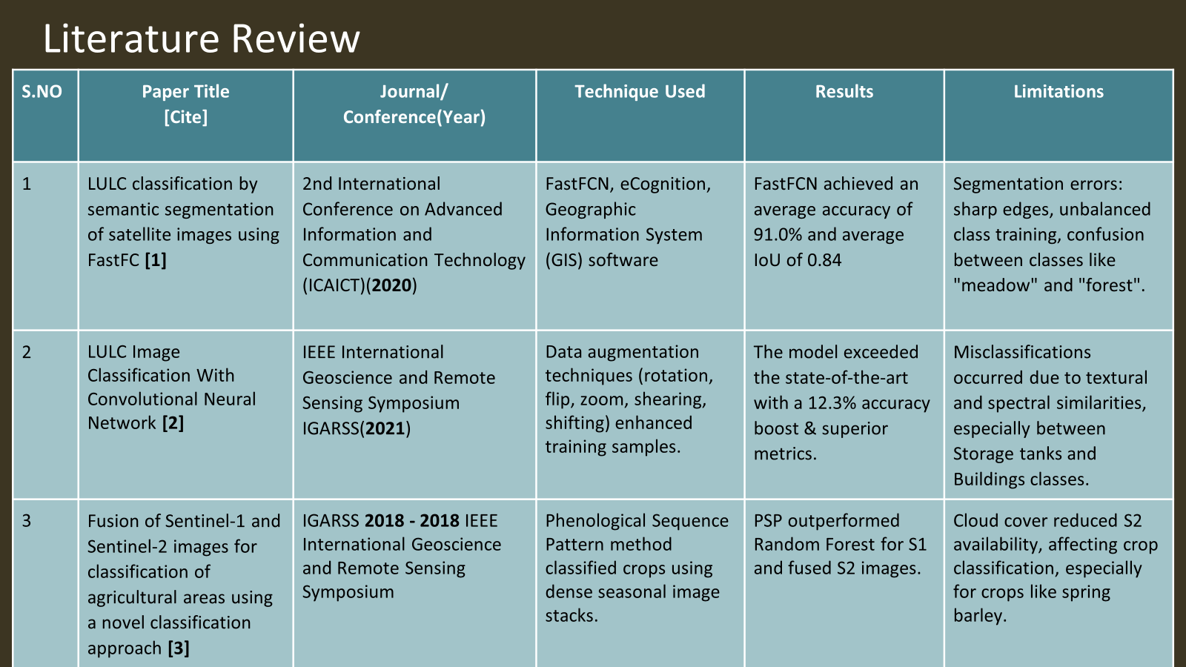
CONT..

Slide 6
S. NO | Paper Title [Cite] | Journal/ Conference(Year) | Technique Used | Results | Limitations
4 | A Multiclass Deep Learning Approach for LULC Classification of Multispectral Satellite Images [4] | IEEE India Geoscience and Remote Sensing Symposium (InGARSS) (2020) | The paper uses a modified SegNet for multispectral satellite image segmentation. | Four major LULC classes - water, forests, crops, and built-up areas - classified with an average F1 score of 0.84. | The study's focus on Mandya, Karnataka, India, may restrict its generalizability to other regions.
5 | A Tile-Based Approach for the LULC Classification of Sentinel Image Using Deep Learning Techniques [5] | Presented at the International Conference for Advancement in Technology (ICONAT) (2022) | Deep learning techniques, including ResNet50, VGG16, and DenseNet201, for Sentinel-2 land use classification. | ResNet50 achieved the highest classification accuracy of 98.47% on the test data. DenseNet201 achieved an accuracy of 90.23%. | Manual labeling by domain experts in dataset creation may introduce subjective biases and may not be scalable for large-scale mapping projects.
6 | From Supervised to Unsupervised Learning for Land Cover Analysis of Sentinel-2 Multispectral Images [6] | GARSS 2020 - 2020 IEEE International Geoscience and Remote Sensing Symposium . | CNN architecture, Unsupervised land cover classification, Band combination for feature extraction from Sentinel-2 | CNN architecture, Transfer learning from pre-trained hyperspectral model | Limited discussion on scalability and generalization across diverse regions or land cover types.

Slide 7
S.NO | Paper Title [Cite] | Journal/ Conference(Year) | Technique Used | Results | Limitations
7 | Best Accuracy Land Use/Land Cover (LULC) Classification to Derive Crop Types Using Multitemporal, Multisensor, and Multi-Polarization SAR Satellite Images [7] | Foody, G.M. Status of land cover classification accuracy assessment. Remote Sens. Environ. (2002) | Maximum Likelihood and Random Forest classifiers for LULC classifications | Highly accurate LULC maps with up to 8m resolution was achieved with improved crop classification accuracy | Cloud cover limited optical image use
8 | Deep Learning Methods for Land Cover and Land Use Classification in Remote Sensing [8] | A. Hamida, A. Benoit, P. Lambert, and C. Amar, “3-D Deep Learning Approach for Remote Sensing Image Classification,” IEEE Trans. Geosci. Remote Sens., vol. 56, no. 8, pp. 4420–4434, (2018) | Advanced DL methods such as CNN, GAN, RNN are utilized for land cover classification | DL methods show high accuracy for LCLU classification in RS imagery | Limited data availability, model complexity, and training time constraints in deep learning research.

Slide 8
Problem Statement and Objective:
Problem Statement:
Automatic categorization and classification of Land Use Land Cover (LULC) is important for sustainable development, autonomous agriculture, and urban planning. The challenge before us revolves around creating an Automated LULC classification system.
This specific task is formulated as a multi‐class classification problem, requiring the development of a model that can precisely categorize various LULC Level‐2 classes.
Objective:
Develop robust DNN (Deep Neural Network)/ML (Machine Learning) models to predict LULC Level‐2 classes using Satellite Datasets.

Slide 9
Tools, Technologies and Datasets:
CONT..
GPU : GPU accelerates LULC classification in ML due to its computational efficiency.
Python : Python is a popular programming language for ML projects.
IDE(Integrated Development Environment): Popular Python IDE such as Google Colab provide an interactive and efficient environment for coding , debugging and experimentation.
Tools : Google Colab, Google Earth Engine,QGIS
1.Google Colab: A cloud-based platform for writing, executing, and sharing Python code, particularly suited for machine learning and data analysis tasks.
2.Google Earth Engine: A platform for planetary-scale environmental data analysis, providing access to a vast archive of satellite imagery and geospatial datasets for scientific research and applications.
3.QGIS: An open-source geographic information system (GIS) software for viewing, editing, and analyzing geospatial data, offering advanced capabilities for spatial analysis and visualization.
Dataset: Harmonized Sentinel-2 MSI: MultiSpectral Instrument, Level-2A [9]

Slide 10
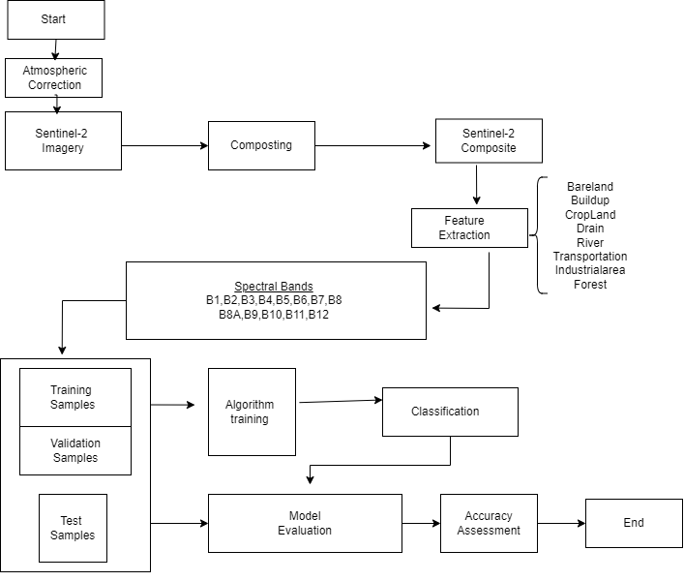
System
Design:
Fig. 1 Flowchart

Slide 11
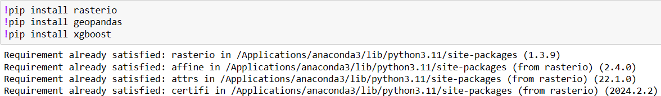
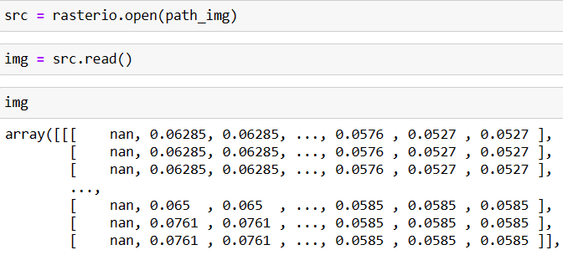
Pseudo Code:
Environment Setup
install and import ["rasterio", "geopandas", "xgboost", "matplotlib", "seaborn"]
Read and Visualize Sentinel-2 Imagery
sentinel_data = rasterio.open("path_to_sentinel_data")
plt.imshow(sentinel_data.read(1))
plt.show()

Slide 12
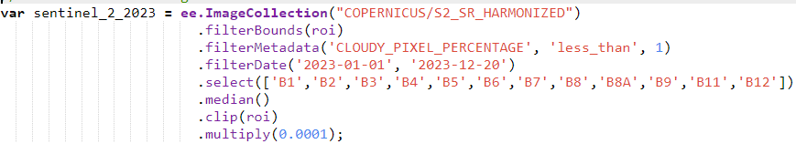
Load and Filter Image Collections
filtered_images = ee.ImageCollection('COPERNICUS/S2').filterDate(start_date, end_date).filterBounds(ROI).filterMetadata('CLOUDY_PIXEL_PERCENTAGE', 'less_than', 10)
Define Classes and Features
land_cover_classes = ["forest", "river", "drains", "transportation", "industrial_area", "bareland", "cropland", "buildup"]
features = get_spectral_bands(sentinel_data)

Slide 13
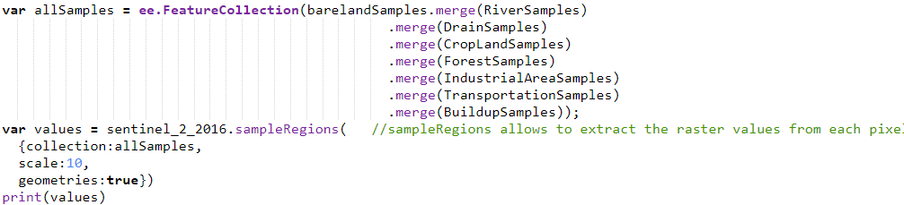
Generate Sampling Points and Extract Raster Values
sampling_points=generate_random_points(ROI, num_points) raster_values = extract_raster_values(sentinel_data, sampling_points)
Split Samples and Export Data
training_set, testing_set = split_data(raster_values, test_size=0.2)
export_to_drive(training_set, "training_set.csv")

Slide 14
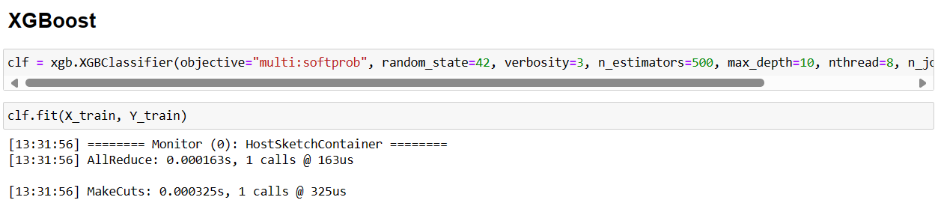
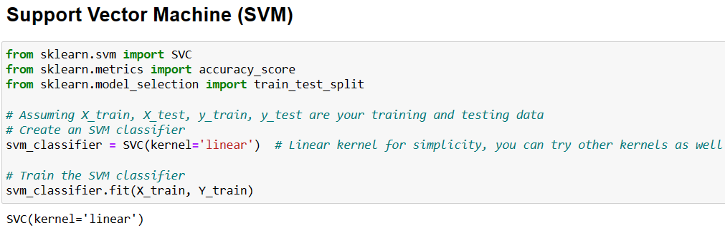
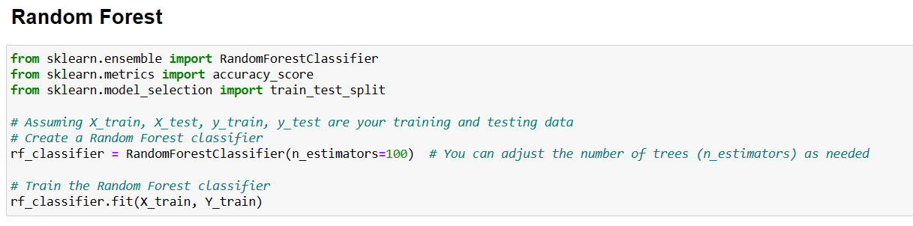
Train and Evaluate Models
Train and Evaluate Machine Learning Models
initialize classifiers: XGBoost, Random Forest, Support Vector Machine (SVM)
train each model with training data
evaluate performance using metrics
Visualize Classification Results
classification_map = model.predict(sentinel_data)
plt.imshow(classification_map)0
plt.show()

Slide 15
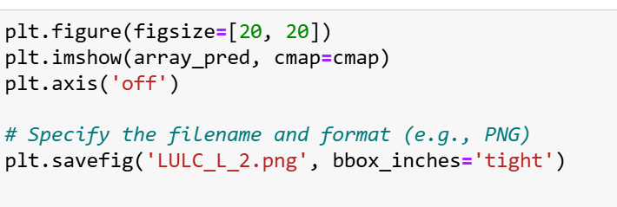
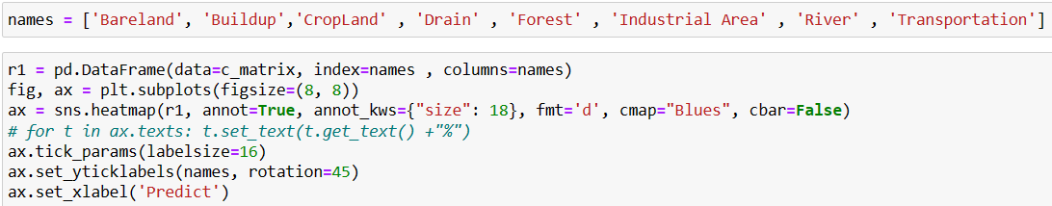
Document and Share Results
generate_reports(["classification_report", "confusion_matrix"])
create_dashboard(results)

Slide 16
Experimental Result and Analysis:
S.No | Model | Accuracy
1. | XGBoost Classifier | 68%
2. | Random Forest Classifier | 76%
3. | Support Vector Machine Classifier | 27%
Table 1 - Result Analysis
The Random Forest classifier achieved the highest accuracy at 76%outperforming the XGBoost classifier, which had an accuracy of 68%.
In contrast, the Support Vector Machine (SVM) classifier lagged significantly behind with an accuracy of just 27%.
This highlights the superior performance of the Random Forest model in this particular classification task. Further analysis is needed to understand performance differences, focusing on hyperparameter tuning, feature selection, and dataset characteristics. It's also important to consider the limitations and assumptions of each algorithm. While XGBoost showed overfitting tendencies, Random Forest demonstrated strong performance and may be a suitable alternative for similar classification tasks.

Slide 17
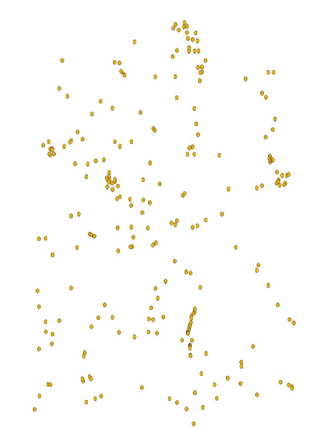
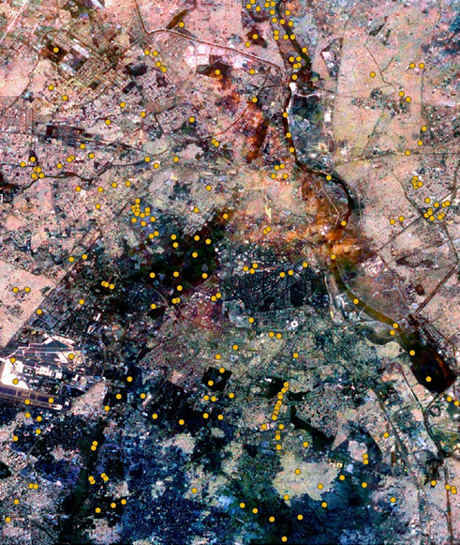
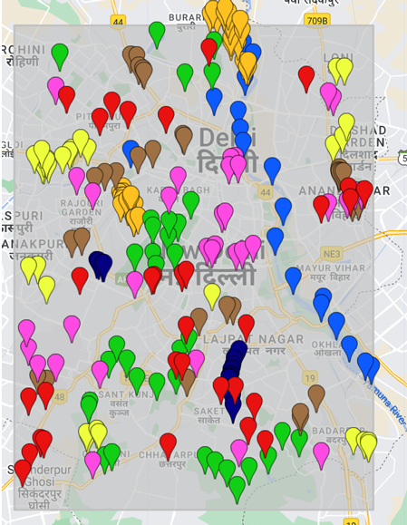

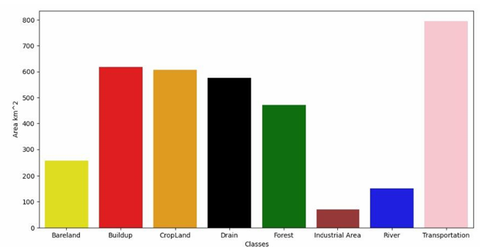
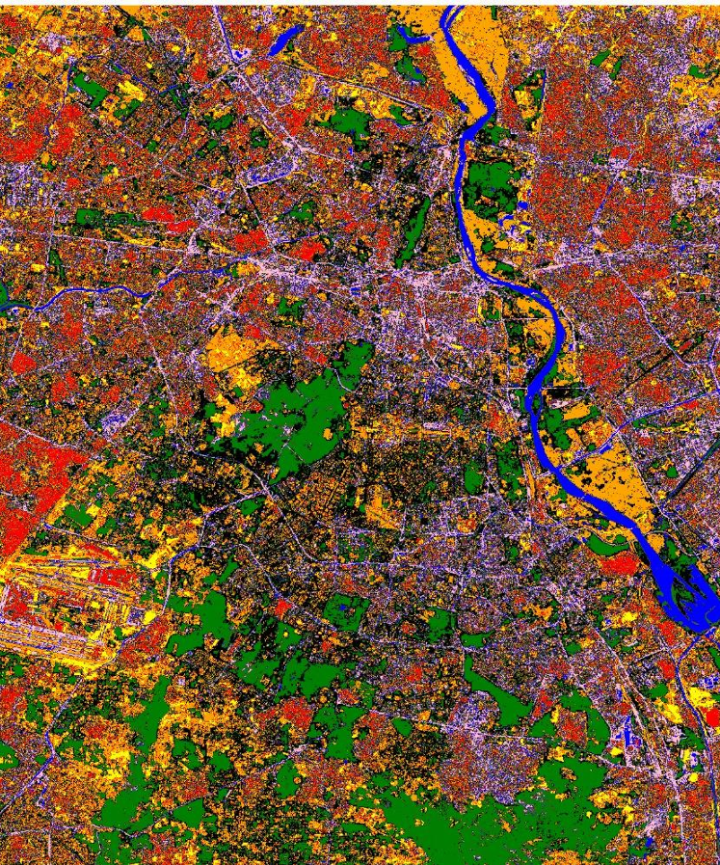
CONT..
Image with training points
Training point
SHP file
LULC
LEVEL-2
MAP
AREA COVERED BY DIFFERENT TYPES OF LAND

Slide 18

CONCLUSION
Utilized Google Colab, Google Earth Engine, QGIS, and Jupyter Notebook for comprehensive land cover classification.
Employed XGBoost, Random Forest, and SVM machine learning models to analyze satellite imagery, with Random Forest demonstrating the highest accuracy.
Outlined future research directions including refining classification algorithms, incorporating multi-sensor data, and expanding project scope.
Provided recommendations to guide ongoing efforts in the field of LULC classification.
.

Slide 19
References:
[1]- H. Caesar, J. Uijlings, and V. Ferrari, “Coco-stuff: Thing and stuff classes in context,” in Proceedings of the IEEE Conference on Computer Vision and Pattern Recognition, 2018, pp. 1209–1218.https://ieeexplore.ieee.org/document/9333522
[2]- R. Torres, Paul Snoeij, Dirk Geudtner, David Bibby, Malcolm Davidson, Evert Attema, Pierre Potin, BjOrn ̈ Rommen, Nicolas Floury, Mike Brown, Ignacio Navas Traver, Patrick Deghaye, Berthyl Duesmann, Betlem Rosich, Nuno Miranda, Claudio Bruno, Michelangelo L’Abbate, Renato Croci, Andrea Pietropaolo, Markus Huchler, and Friedhelm Rostan, “GMES Sentinel-1 mis-sion,” Remote Sensing of Environment, vol. 120, pp. 9–24, 2012. https://ieeexplore.ieee.org/document/8518327
[3]- Y. Zhou et al., “Remote sensing scene classification based on rotation-invariant feature learning and joint decision making,” EURASIP Journal on Image and Video Processing, no.3, pp. 1–11, 2019. https://ieeexplore.ieee.org/document/9555015
[4]- D. Roy et al., “Landsat-8: Science and product vision for terrestrial global change research,” Remote Sensing of Environment, vol. 2014, pp. 154–172, 03 2014.https://ieeexplore.ieee.org/document/9358947

Slide 20
[5]- J.G.P.W. Clevers and A.A. Gitelson, “Remote estimation of crop and grass chlorophyll and nitrogen content using red-edge bands on sentinel-2 and -3,” International Jour-nal of Applied Earth Observation and Geoinformation,vol. 23, pp. 344 – 351, 2013.https://ieeexplore.ieee.org/document/9323985
[6]- Helber, Patrick, Benjamin Bischke, Andreas Dengel, and Damian Borth."Eurosat: A novel dataset and deep learning benchmark for land use and land cover classification." IEEE Journal of Selected Topics in Applied Earth Observations and Remote Sensing 12, no. 7 (2019): 2217-2226.
https://ieeexplore.ieee.org/document/9726030
[7] -Foody, G.M. Status of land cover classification accuracy assessment. Remote Sens. Environ. 2002, 80, 185–201 https://www.mdpi.com/2072-4292/8/8/684
[8] A. Hamida, A. Benoit, P. Lambert, and C. Amar, “3-D Deep Learning Approach for Remote Sensing Image Classification,” IEEE Trans. Geosci. Remote Sens., vol. 56, no. 8, pp. 4420–4434, 2018. https://ieeexplore.ieee.org/document/9197824
[9] https://developers.google.com/earth-engine/datasets/catalog/COPERNICUS_S2_SR_HARMONIZED#bands

Slide 21
Thank You

